Slide 1
Pattern Recognition

Slide 2
Introduction
Pattern Recognition (PR) is an important aspect of Artificial Intelligence (AI)

Slide 3
What is AI ?
AI is the part of computer science concerned with designing intelligent computer systems that exhibit the characteristics we associate with intelligence in human behavior - understanding language, learning, reasoning and solving problems etc.

Slide 4
Some topics of AI
Natural Language Processing to enable it to communicate successfully in natural languages.
Knowledge Representation to store what it knows.
Automated Reasoning to use stored information to answer questions and to draw new conclusions.

Slide 5
Contd…
Machine Learning to adapt to new circumstances and to detect patterns.
Computer Vision to perceive objects.
Robotics to manipulate objects and move about.
Note : In every aspect of human intelligence recognition and / or learning is involved.

Slide 6
Some Examples of Learning…
When we see we recognize or learn
When we hear we recognize or learn
When we touch we recognize or learn
When we smell we recognize or learn
When we taste we recognize or learn

Slide 7
Contd…
In fact, whatever we do with our five sense organs is either a kind of recognition or learning.
Thus recognition is an important part of human intelligence. And accordingly, pattern recognition has become an important part of Artificial Intelligence.
The problem of pattern recognition can be divided into two parts :

Slide 8
Part-1…
First part : It is concerned with the study of recognition mechanism of patterns by human and other living organism. This part is related to the disciplines like physiology, psychology, biology, etc.

Slide 9
Part-2…
Second part : It deals with the development of theory and techniques for designing a device which can perform these recognition tasks automatically. This area is related to engineering, computer and information sciences. In this curriculum, we shall be dealing with the second part i.e. the problems of automatic machine recognition of patterns.

Slide 10
Role of memory in pattern recognition
There are two aspects of the memory in this process.
First, the part which holds the information we can recall, e.g., a poem, a face, a vocabulary, a theorem etc. To use computer terminology, this form of memory is addressable, and its content can be recalled In this type of problem, PR is a two-step process :
Knowledge representation
Searching

Slide 11
Contd…
Secondly, the information which presumably is stored somewhere, but which we cannot retrieve, such as we cannot describe how we balance when we walk, how we recognize a speech or how we drive a car or similar aspects of pattern processing, although the information must be stored somewhere in our brain and nervous system.

Slide 12
Contd…
This form of memory is not addressable, and its content can not be recalled. In this case, the PR process is a two-fold task :
Developing some decision rules based on previous knowledge (Learning)
Use it for taking decision regarding an unknown pattern (Classification)

Slide 13
Some of the important Pattern Recognition application areas
MAN-MACHINE Communication-
  Automatic Speech Recondite,
  Speaker Identification,
  OCR Systems,
  Cursive Script Recognition
  Image Understanding.

Slide 14
Contd…
BIOMEDICAL Applications-
ECG, EEG, EMG Analysis,
Cytological, Histological and other Stereological Applications,
X-ray Analysis
Medical Diagnostics.

Slide 15
Contd…
APPLICATION IN PHYSICS–
High Energy Physics,
Bubble Chamber and other Forms of Track Analysis.
CRIME AND CRIMINAL DETECTION-

Slide 16
Contd…
Fingerprint,
Hand Writing
Speech Sound and
Photographs
NATURAL RESOURCES STUDY AND Estimation-

Slide 17
Contd…
  (a) Agriculture,
  (b) Hydrology,
  (c) Forestry,
  (d) Geology,
  (e) Environment,
(f) Cloud Pattern,
(g) Urban Quality

Slide 18
Contd…
STEREOLOGICAL APPLICATIONS-
Metal Processing.
Mineral Processing and
Biology.
MILITARY APPPICATIONS-

Slide 19
Contd…
Detection of Nuclear Explosions,
Missile Guidance and Detection
Radar and Sonar Signal Detection,
Target Identification.
Naval Submarine Detection etc.

Slide 20
What is Pattern ?
A pattern is a description of an object that we are going to recognize.
Description means a set of measurements
But all these measurements are not significant in the context of recognition

Slide 21
Example
Given a set of professional basketball players and wrestlers, how to recognize an individual of the set to be a player of any one of these two games.
Measurements : Age, Qualification, Height, Weight
Basis of feature selection : Basketball players are taller and slimmer, whereas wrestlers are comparatively shorter and heavier.
Feature: Height, Weight.

Slide 22
Pattern vector or Feature vector
When each feature is considered as a component of a vector, it is called a Pattern vector or Feature vector.
Feature Space
A pattern vector is represented as a point in n-dimensional Euclidian space

Slide 23
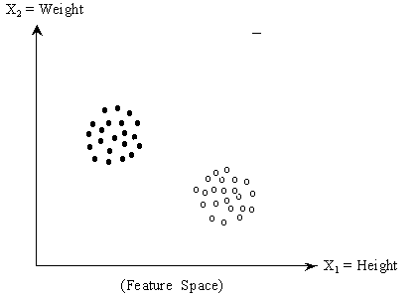
Contd…
-

Slide 24
Decision Space
When different regions of the feature space are identified to belong to different classes, then such a space is called a decision space

Slide 25
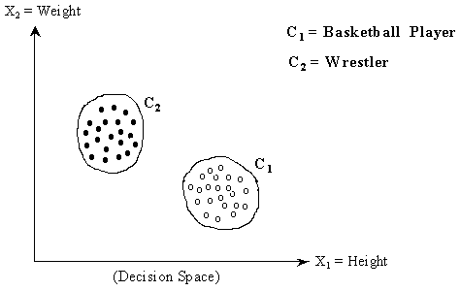
Contd…

Slide 26
Operating stages in a Pattern Classifier
Steps in a typical PR System
Physical
System
Measure-ment Space
Feature
Space
Decision Space

Slide 27
Classification of PR
Pattern Recognition
Supervised
Unsupervised
Non-Hierarchical
(Partitional)
Hierarchical

Slide 28
Different approaches in PR techniques/methodologies
Pattern Classification by Decision Functions
Pattern Classification by Distance Functions
Pattern Classification by Likelihood Functions
Trainable Pattern Classifiers-The Deterministic Approach
Trainable Pattern Classifiers-The Statistical Approach
Syntactic Pattern Recognition
Pattern Preprocessing and Feature Selection

Slide 29

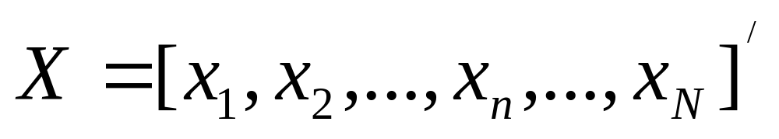
Pattern Classification by Decision Functions
Let C₁,C₂,…C_{j},…C_{m} be designated as the m possible pattern classes in an N-dimensional feature vector space and let

Slide 30
Contd…
be the unknown pattern vector, where x_{n} represents the nth feature measurement.
If the pattern X is a member of class C_{k} the decision function D_{k}(X) associated with the class C_{k},k=1.2,…m must then possess the largest value. In other words,

Slide 31
Contd…
Decide X€C_{k} if D_{k}(X) > D_{j}(X) with K≠j, k,j=1,2,…,m.
Ties are resolved arbitrarily. The decision boundary in the N-dimensional feature space Ω_{x,} between regions associated with classes C_{k} and C_{j} respectively would be governed by the expression

Slide 32
Contd…
D_{k}(X) – D_{j}(X) =0 with k≠j, k,j=1,2,…,m.
Let us now consider two hypothetical pattern classes in R² as shown below

Slide 33
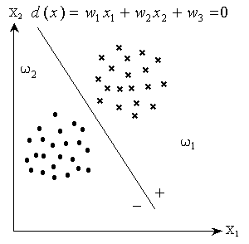
Contd…
-
Figure : A simple decision function for two pattern classes

Slide 34
Contd…
Let d(x)=w₁x₁+w₂x₂+w₃ be the equation of a separating line where the w’s are parameters and x₁,x₂are the general coordinate variables.
It is clear from the figure that
X€C₁(or ω₁), if D(X)>0 and X€C₂(or ω₂) if D(X)<0

Slide 35
Contd…
The success of the said pattern classification scheme depends on two factors :
  The form of d(X)
  One’s ability to determine its coefficients
The first problem is directly related to the geometrical properties of the pattern classes under consideration. Unless some a priori information is available,

Slide 36
Contd…
the only way to establish the effectiveness of a chosen decision function is by direct trial.
Once a certain function (or functions if more than two classes are involved) has been selected, the problem becomes the determination of the coefficients. Several adaptive and training schemes exist that can solve this problem.

Slide 37
Contd…
Sometimes, some sample pattern can be utilized in order to determine the coefficients which characterize an already specified decision function.

Slide 38
General n-dimensional form of decision function
A general linear decision function is of the form
d(X)=w₁x₁+w₂x₂+…+w_{n}x_{n}+w_{n+1}
= W’₀ X+w_{n+1} where W₀=(w₁,w₂,….,w_{n})’
This vector is referred to as weight or parameter vector.

Slide 39
Contd…
It is a widely accepted convention to append a 1 after the last component of all pattern vectors
d(X)=W’X
where X=(x₁,x₂…..x_{n},1)’ and W=(w₁,w₂,……w_{n},w_{n+1})’ are called augmented pattern and weight vectors, respectively. Since the same quantity is equally appended to all patterns, the basic geometrical properties of the pattern classes are not disturbed.

Slide 40
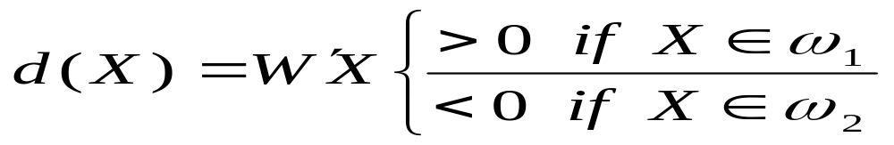
Contd…
In the two-class case a decision function d(X) is assumed to have the property
When we have more than two classes, denoted by w₁,w₂…w_{M} we consider the following multi-class cases.

Slide 41
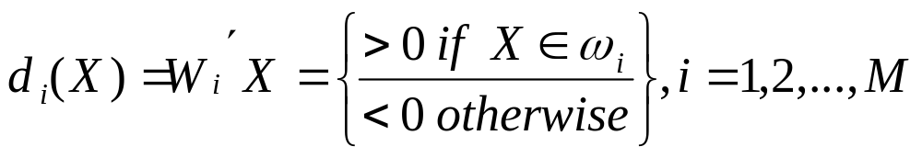
Contd…
Case 1. Each pattern class is separable from the other classes by a single decision surface. In this case there are M decision functions with the property

Slide 42
Contd…
Where W_{i}=(w_{i1},w_{i2},….,w_{in},w_{i,n+1})’ is the weight vector associated with the i^{th} decision function
Case 2. Each pattern class is separable from every other individual class by a distinct decision surface, that is the classes are pairwise separable. In this case there are M(M-1)/2 (the combination of M classes taken two at a time) decision surface. The decision functions here are of the from d_{ij}(X)=W_{ij}’X and have the property that,

Slide 43
Contd…
if x belongs to class ω_{i} then d_{ij}(X)>0 for all j≠i
These functions also have the property that d_{ij}(X)=-d_{ji}(X)
It is not uncommon to find problems involving a combination of class 1 and 2. These situations require fewer than the M(M-1)/2 decision surfaces which would be needed if all the classes were only pairwise separable.

Slide 44
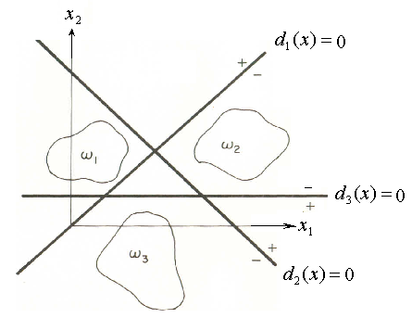
Example-1
A simple example of multi-class case-1 is shown in the following figure

Slide 45
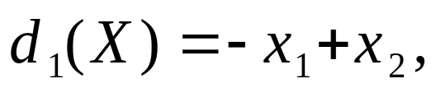

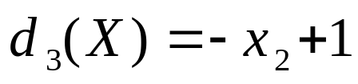
Contd…
It is noted that each class is separable from the rest by a single decision boundary.
if x belongs to class ω₁, then d₁(X)>0 while d₂(X)<0 and d₃(X)<0
The boundary between class ω₁ and the other classes is given by the values of x for which d₁(X)=0
As a numerical illustration assume that the decision functions of the above Figure to be

Slide 46
Contd…
The three decision boundaries are, therefore,
-x₁+x₂=0, x₁+x₂-5=0, -x₂+1=0
For example, suppose that it is desired to classify the pattern x=(6,5)’. Substituting this pattern into the three decision function yields

Slide 47
Contd…
d₁(X)=-1, d₂(X)=6, d₃(X)=-4
Since d₂(X)>0while d₁(X)<0 and d₃(X)<0 the pattern is assigned to class ω₂

Slide 48


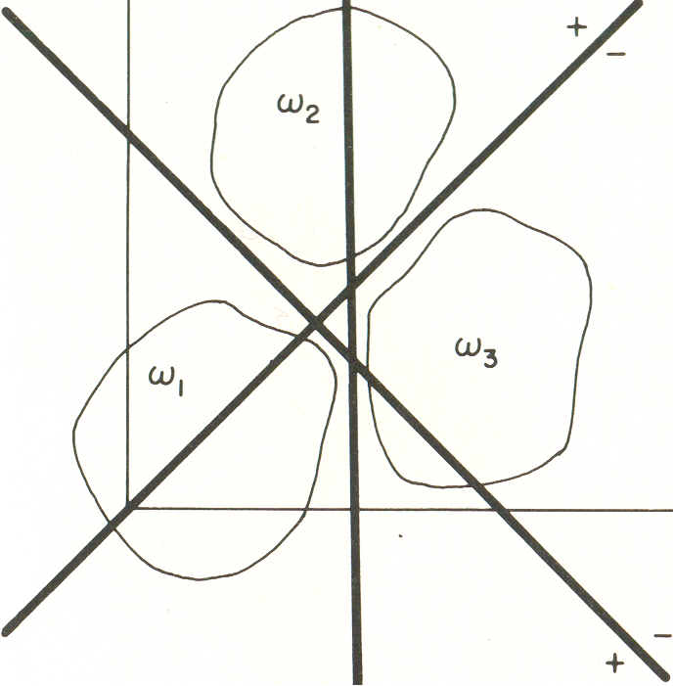



Example2
The following Figure illustrates three pattern classes separable under case 2 conditions.

Slide 49
Contd…
Here no class is separable from the other by a single decision surface. Each boundary shown is capable of separating just two classes.
Let us assume the following numerical values:
d₁₂(X)=-x₁-x₂+5, d₁₃(X)=-x₁+3, d₂₃(X)=-x₁+x₂

Slide 50
Contd…
The decision boundaries are again determined by setting the decision function equal to zero. The decision regions, however, are now given by the positive sides of multiple decision boundaries.
For example, if x belongs to class ω_{i} then d₁₂(X)>0 and d₁₃(X)>0

Slide 51
Contd…
The value of d₂₃(X) in this region is irrelevant since d₂₃(X) is not related to class ω₁.
Suppose that it is desired to classify the pattern x=(4,3)’. Substitution of this pattern into above decision functions yields
d₁₂(X)=-2, d₁₃(X)=-1, d₂₃(X)=-1

Slide 52
Contd…
Since these functions have the property that d_{ij}(X)=-d_{ji} (X).
It follows that d₂₁(X)=2, d₃₁(X)=1, d₃₂(X)=1
That is, d_{3j}(X)>0 for j=1,2
Therefore we assign the pattern to class ω₃.

Slide 53
Geometrical properties of linear decision functions (Hyperplane Properties)
In the two-class problem, as well as multi-class cases 1 and 2, the equation of the surface separating the pattern classes is obtained by letting the decision functions be equal to zero. In other words, in the two-class case the surface between the two pattern populations is given by the equation

Slide 54
Contd…
d(X)=w₁x₁+w₂x₂+…+w_{n}x_{n}+w_{n+1}=0…….….(1)
In case 1, the equation of the boundary ω_{i} between and the remaining classes is given by
d_{i}(X)=w_{i1}x₁+w_{i2}x₂+….+w_{in}x_{n}+w_{i,n+1}=0….….(2)

Slide 55
Contd…
Similarly, In case 2, the boundary between ωi and ωj is given by
d_{ij}(X)=w_{ij1}x₁+w_{ij2}x₂+….+w_{ijn}x_{n}+w_{ij,n+1}=0
In general, the equation of the decision surface between classes ω_{i} and ω_{j} is given by
d(X)=w₁x₁+w₂x₂+…+w_{n}x_{n}+w_{n+1}=0

Slide 56
Contd…
= W’₀X+w_{n+1}=0…………..(3)
Where W₀=(w₁,w₂…..w_{n})’
Equation (3) is recognized as the equation of a line when n=2 and as the equation of a plane when n=3. When n>3, Eq. (3) is the equation of a hyperplane.

Slide 57
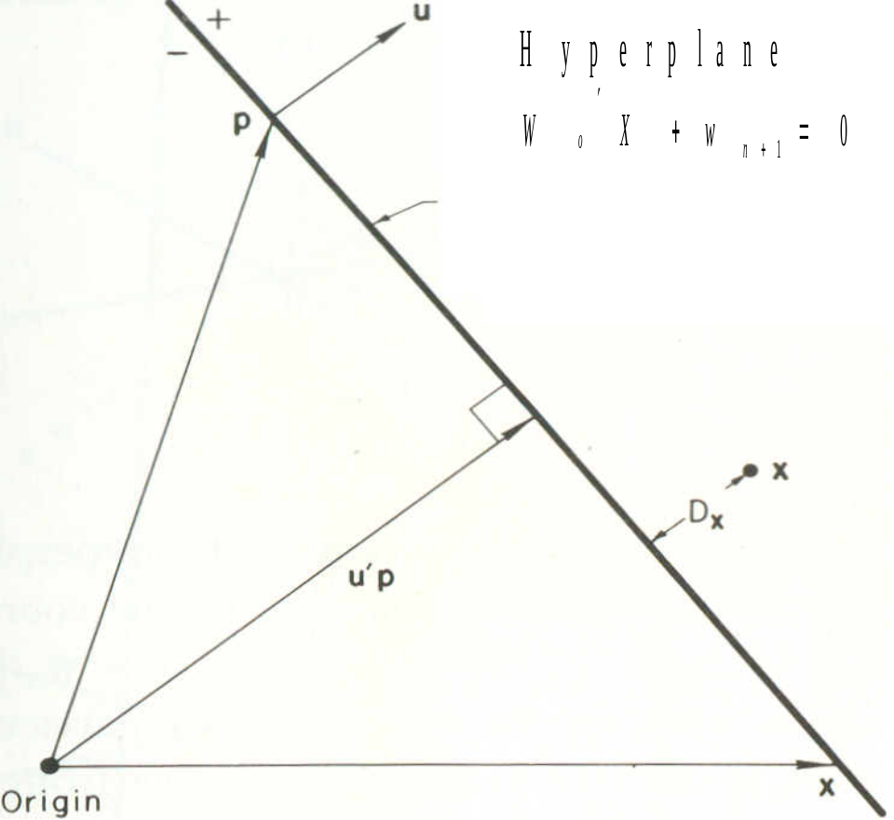
Contd…
A “hyperplane” is schematically shown in the following figure.
Figure 1. Some geometrical properties of hyperplanes

Slide 58
Contd…
Let u be a unit normal to the hyperplane at same point p and oriented to the positive side of the hyperplane. From geometrical considerations the equation of the hyperplane may be written as
u’(x-p)=0……………(4)
or
u’x=u’p….……………(5)

Slide 59
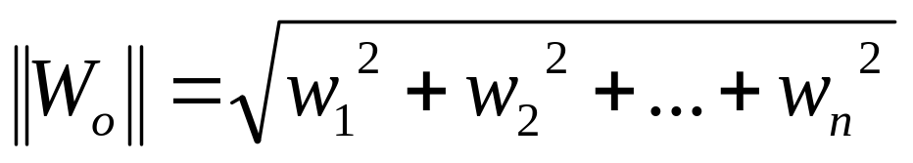
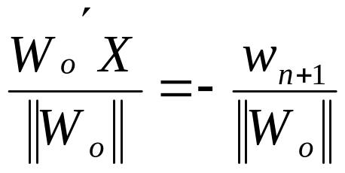
Contd…
Dividing Eq. (3) by results in the equation
………………………(6)
Comparing Eqs. (5) and (6), we see that the unit normal to the hyperplane is given by

Slide 60
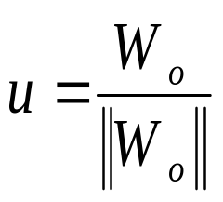
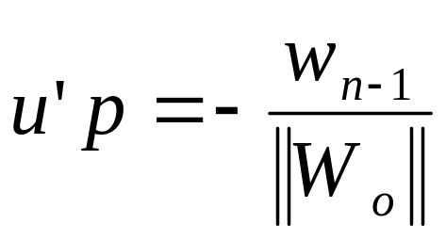
Contd…
………………(7)
Also,
………………(8)

Slide 61
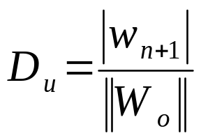
Contd…
It is seen by comparing Fig. 1 and Eq. (8) that the absolute value of u’p represents the normal distance from the origin to the hyperplane. Denoting this distance by D_{u’} we obtain
……………………(9)

Slide 62
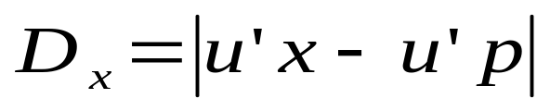
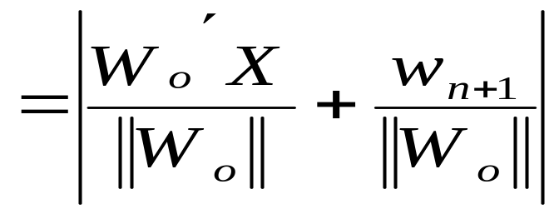
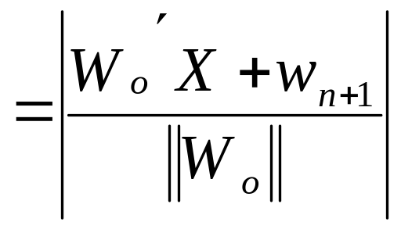
Contd…
From Fig. 1 it also reveals that the normal distance D_{x} from the hyperplane to an arbitrary point x is given by

Slide 63
Contd…
The unit normal u indicates the orientation of the hyperplane. If any component of u is zero, the hyperplane is parallel to the coordinate axis which corresponds to that component. Therefore, since,u=W_{o}/||W_{o}|| it is possible to tell by inspection of the vector W₀ weather a particular hyperpalne is parallel to any of the coordinate axes. We also see from Eq. (9) that if w_{n+1}=0 the hyperpalne passes through the origin.

Slide 64
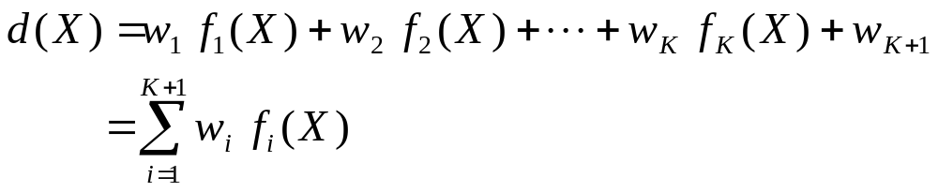
Generalized Decision Functions
A generalized form of the decision function can be defined as :
…………………………(1)

Slide 65
Contd…
where the {f_{i}(X),i=1,2,…,K, are real, single-valued functions of the pattern X,f_{k+1}(X)=1, and K+1 is the number of terms used in the expansion. The Eq.(1) represents an infinite variety of decision functions, depending on the choice of the functions {f_{i}(X)} and on the number of terms used in the expansion.

Slide 66
Contd…
In spite of the fact that the above equation could represent very complex decision functions, it is possible to treat these functions as linear by virtue of a transformation. For that we define a vector X* whose components are the functions f_{i}(X), that is,

Slide 67
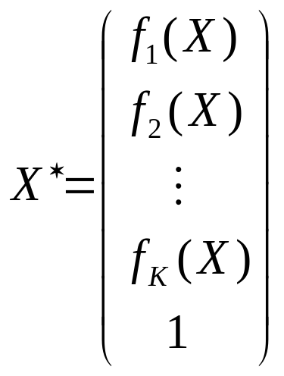

Contd…
……………………..……………(2)
Using Eq. (2), we may express (1) as
…………(3)

Slide 68
Contd…
where W=(w₁,w₂,….,w_{k},w_{k+1})’.
Once evaluated, the functions {f_{i}(X)} are nothing more than a set of numerical values, and X* is simply a K-dimensional vector which has been augmented by 1. Therefore, Eq. (3) represents a linear function with respect to the new patterns X*. Thus any decision function of the form shown in Eq. (1) can be treated as linear by virtue.

Slide 69
Thank You

